Slide 2

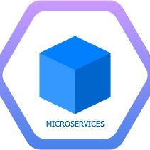
NAGP
Complex is Simple
New Technology Exploration Group
Microservices Architecture
Session 2

Slide 3

Re-cap

Slide 4
What we talked about last time…
Distributed computing
Scalability
Load Balancing
Monolithic -> Service Oriented -> Microservices
Advantages of microservices
When to use microservices
Best practices
Deployment patterns
Dockers
Container orchestration

Slide 5
Reference Architecture

Slide 6
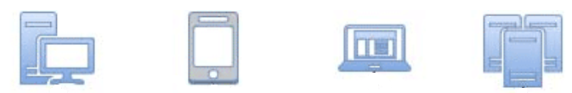
API Gateway
Service Registry/
Service Discovery
Configuration Server
Load Balancer
Security
Operational Capabilities
(Automation, Monitoring, Orchestration etc.)
Microservice 3
Microservice 1
Microservice 2
Microservice 4
Database
Database
Database
Database
Communication Layer

Slide 7
Before we get started
Visual Studio 2019
ASP.NET Core 3.1 and 2.2.0
Git
Do a git clone
https://apurvasawhney.visualstudio.com/MSA2020/_git/MSA2020

Slide 8
API Gateway

Slide 9
API gateway’s responsibility
API Gateway is single entry point for all microservices.
Request routing
API Composition
Protocol translation
Authentication
Authorization
Caching
Request Logging
Metric Collection
Rate Limiting

Slide 10
Architecture
Browser
HTML/ Javascript
Firewall
Backend Services
API Gateway
Microservice 1
Web
Application
Microservice 2
Iphone/Android
Application
……
Microservice n
3rd Party
Application
The API gateway is the single entry-point into the application for API calls from outside the firewall
Slow performance internet
High performance internet

Slide 11
Request routing
When it receives a request, the API gateway consults a routing map that specifies which service to route the request to.
API Gateway
Backend Services
GetUser()
User service
Web/Iphone
/Andoid
Consumer Application
GetUsers()
Movie service
Slow performance internet
High performance internet

Slide 12
API Composition
When it receives a request, the API gateway consults a routing map that specifies which service to route the request to.
API Gateway
Backend Services
GetUsers()
User service
Web/Iphone
/Andoid
Consumer Application
GetUsersAndMovies()
GetMovies()
Movie service
Slow performance internet
High performance internet

Slide 13
Hands-on
Create first web API
Create second web API
Run both check get URL.
Create 3rd web API(API gateway).
Add nuget of Ocelot
Add config for ocelot
Change Startup.cs
Change program.cs

Slide 14
Service Discovery & Service Registry

Slide 15
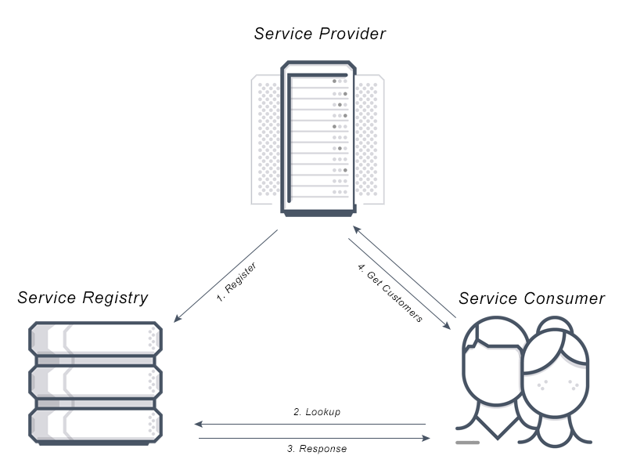
What is Service Discovery?
Service discovery is the process through which applications and other (micro)services locate each other on a network such that there is no need for a long configuration set up process.
It include both:
A central server (or servers) that maintain a global view of addresses.
Clients that connect to the central server to update and retrieve addresses.

Slide 16
What is Service Registry?
Service Registry is database of services, their instances and their locations. Since service registry is the database of services available, it must be highly available. There are two stages of interaction with Service Registry
Registration — whenever a new service or service instance scales in/out, it needs to register/de-register itself with Service Registry.
Discovery — whenever client needs to interact with service, client would look up for service details or discover service on Service Registry.
Types of Service Registry Registration
Self-Registration : A service instance is responsible for registering itself with the service registry.
On start-up the service instance registers itself (host and IP address) with the service registry and makes itself available for discovery.
The service must periodically renew its registration so that the registry knows it is still alive.
On shutdown, the service instance unregisters itself from the service registry.
Third-party Registration : In this registration allows delegation of service registration/de-registration task to Third-party registrar (service manager) component. On service instance start-up, service manager is responsible for registering the service with Service Registry. Similarly, de-registers on service shutdown.

Slide 17
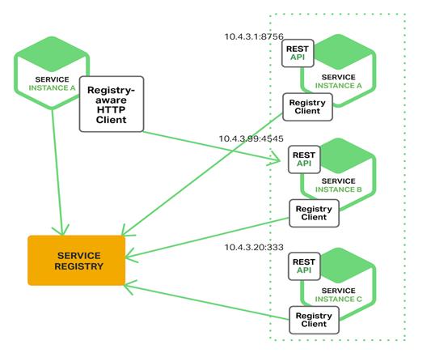
Type of Service Discovery
Client‑Side : Client is responsible for determining the network locations of available service instances (Service Registry) and load balancing requests across them.

Slide 18
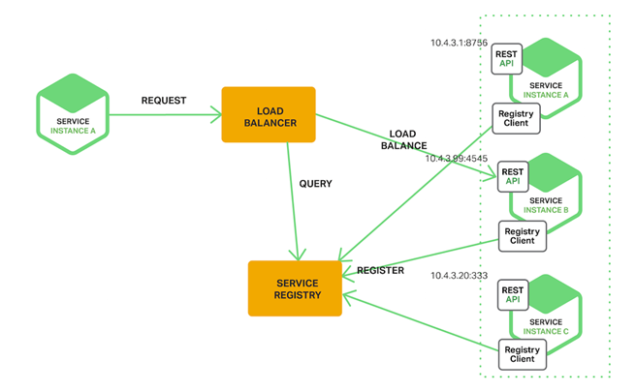
Type of Service Discovery
Server‑Side : Client makes a request to a service who is responsible to queries the service registry and routes each request to an available service instance.

Slide 19
Netflix Eureka
Netflix Eureka is a REST (Representational State Transfer) based service registry that is primarily used for locating the services. It provides a REST API for managing service-instance registration and for querying available instances.

Slide 20
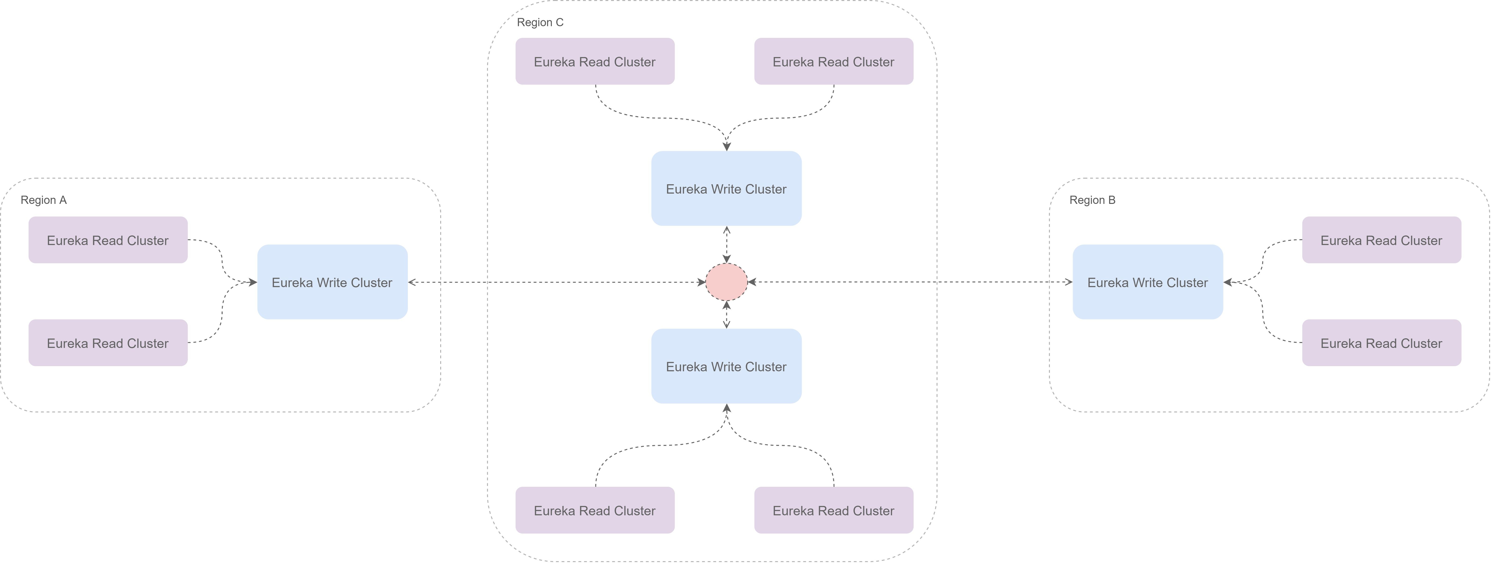
Eureka Client-Server Architecture
Eureka system itself consists of a write and read cluster. The write cluster is a stateful subsystem, which handles client registrations and maintains internal service registry and the registry content is replicated between the all write server nodes in an eventually consistent manner.
The write cluster's registry content is read by the read cluster, that ultimately is used by the Eureka clients.
As the read cluster is effectively a cache layer, it can be easily, and rapidly scaled up and down depending on the volume of the traffic. The write cluster should be pre-scaled with a capacity enough to handle the peek/busy hour traffic. Although it can be scaled up and down dynamically, it needs to be done with more coordination.

Slide 21
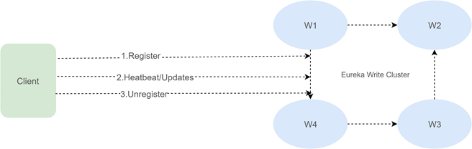
Eureka Client Registration
Eureka clients can register themselves to be discoverable via registration endpoint of the server.
A single client can register multiple service instances and each registration is handled over a separate connection to the write server, as the connection status itself denotes the service liveness. Software heartbeats at the Eureka level is used to determine connection liveness as network stacks in virtualized environments are not 100% trustworthy. If a connection is lost, the registration entry in the write cluster registry is put into the eviction queue, and ultimately remove from the registry.
Well behaving clients should always send unregister request prior to disconnecting. This will result in immediate removal of the service from the registry. After the registration, the client can send any number of update requests, changing its instance data.

Slide 22
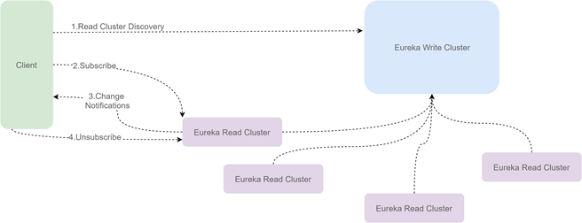
Eureka Registry Discovery
Eureka clients can subscribe to interest sets on Eureka servers. After a successful subscription, all changes to subscribed interests are pushed by the server to the client.

Slide 23
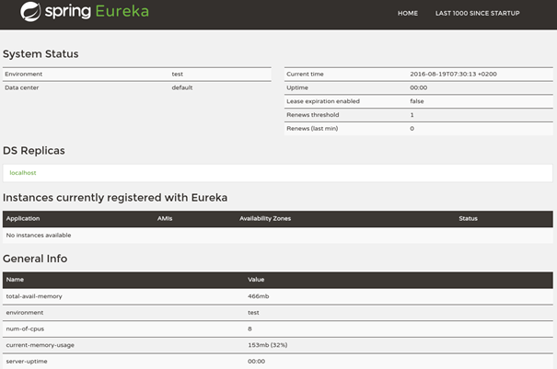
Eureka Dashboard
Eureka dashboard is an optional component, for overall Eureka cluster management. It provides cluster level view, with means to drill down to a specific server instance.

Slide 24
Load Balancing

Slide 25
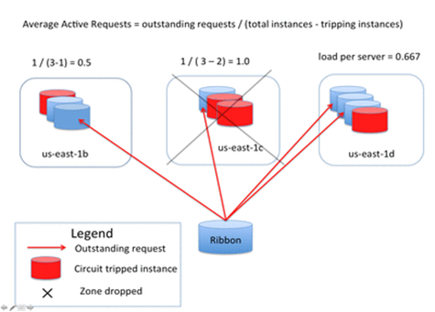
Load balancing
In order to scale the client and microservices independent of each other, a client interacting with a microservices-based application does not need to know about the instances that are serving it. This is precisely the de-coupling that a reverse proxy or a load balancer provides.

Slide 26
Load Balancing Algorithms
Round Robin – Requests are distributed across the group of servers sequentially.​
Least Connections – A new request is sent to the server with the fewest current connections to clients. The relative computing capacity of each server is factored into determining which one has the least connections.​
IP Hash – The IP address of the client is used to determine which server receives the request.​

Slide 27
Fault Tolerance
Circuit breaker pattern

Slide 28
Fault tolerance
Microservices need to be extremely reliable.
Microservices does not automatically mean better availability – unless you have fault tolerant architecture
Have fallbacks in case of microservice failure.
Design critical services in fail-safe manner.
Notes:
It's common for software systems to make remote calls to software running in different processes, probably on different machines across a network. These remote calls can fail or hang without a response until some timeout limit is reached. And the worst part is – if you have multiple callers on a unresponsive supplier, then you can run out of critical resources leading to cascading failures across multiple systems.
Tmeouts prevent service calls from waiting indefinitely for a response.If there is no response by the timeout, the service invokes a fallback mechanism, whether it’s retrying the request, throwing an exception, or something else. Choosing the correct timeout is important. Waiting too long to decide if the call failed will slow down the system and timing out too quickly can consider a successful call as failed. It is important to put timeouts for all the calls, log when timeout occurs look at what happens and change it accordingly.
With a circuit breaker , after a certain number of requests have failed , the circuit breaker is blown. All further requests will fail fast whle the circuit breaker is in blown state. After a certain period of time the client sends a few requests to see if the service has recovered and if it gets enough healthy responses , it resets the circuit breaker.
In our home circuit breakers exist to protect electrical devices from spikes in power. If a spike occurs, circuit breaker gets blows , protecting the home appliances.
Component that can circumvent calls when the system is not healthy
Maintains some threshold value for failures and if it is met, then will break the circuit
A key concept in resilience engineering is Bulkhead. If one component of a system fails but the failure doesn't cascade, you can isolate the problem and rest of the system can keep working. Service boundaries become obvious bulkheads. With microservices we can build systems that handle the total failure of services and degrade functionalities accordingly.
In shipping , a bulkhead is a part of the ship that can be sealed off to protect the rest of the ship. So if ship springs a leak , bulkhead doors could be closed.
Bulkheads pattern partitions capacity to preserve partial functionality when bad things happen
Example – redundancy in deployment, ach instance works as a bulkhead.
According to Let it Crash: rather than trying to handle and recover from all possible failures, you should instead simply fail early and let your processes crash, but then recycle them back into the pool to serve the next request. Plan the system such that , if the components or services in the application did crash, the system could recover with or without human intervention. So how to implement it in practice:
Hardware failures can be handled in cloud without affecting the entire service. At service level , if 1 service fails , application can degrade carefully while service is unavailable or fallback to another instance while the first one is recycling. Nothing should be in critical code path because it might crash. At the network level, we can design topologies such that we do not care if routers or network links crash because there’s always some alternate route through the network. Let them crash and when they come back the optimal routes will be there ready for our application to make use of again in future .Let it crash is more than simple redundancy. It’s about implementing self recoverability of the application. It’s about putting the site reliability efforts into your architecture rather than low level defensive coding.
Suggests getting back to a clean start-up as rapidly as possible, in case the recovery is difficult and unreliable due to a failure
Very common strategy in microservice deployments (one microservice per host strategy with containers)
Rapid server start-up time is also a key aspect

Slide 29
Basic Flow
User Service
http
Movie Service
WebApp
request
response
thread assigned
threadpool

Slide 30

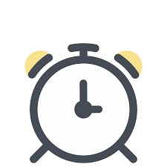
Timeout failure
User Service
http
Movie Service
WebApp
request
Waiting for response
Service could be overloaded
(One of many possible reasons)
request-1
request-2
request-N
threadpool

Slide 31
Timeout failure
User Service
Movie Service
WebApp
request
Cannot serve
requests
request N+1
request N+2
High request rate
Vs threads freed very slowly
= Resource exhaustion
request-N
threadpool

Slide 32
Cascading Failure
User service
movie service

Slide 33
Goal
User Service
Movie Service
WebApp
request
Immediately return default response (so that our threads our not stuck)
Stop calling movie service for some time.
Allow time to recover/scale up
threadpool

Slide 34

Use interceptor for all requests
User Service
Movie Service
WebApp
request
gatekeeper for all requests
call service
successful response
ALLOW
current status
requests interceptor

Slide 35
Stop calling remote service if failure occurs
But, how long to wait ?
Check last N calls for failure
User Service
Movie Service
WebApp
request
Allow time to resolve/scale up
call service
successful 70%
Percentage of failure in last N calls
failed 30%
default response for
subsequent requests
Stop if failure rate > threshold
STOP
Start a timer (duration?)
current status
requests interceptor

Slide 36
Re-allow partially once timer expires
User Service
Movie Service
WebApp
request
call service
allow some calls to go through to check if service is up now
default response (for most)
response/error (for some)
ALLOW PARTIAL
current status
requests interceptor

Slide 37
Status reset once service is back up
User Service
Movie Service
WebApp
request
call service
response/error (for some)
ALLOW
Reset status id service is really up
requests interceptor

Slide 38
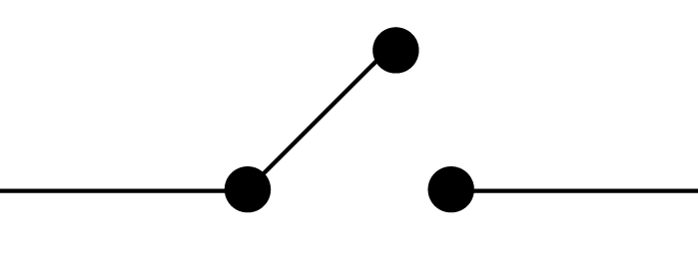
Circuit breaker pattern
User Service
Movie Service
WebApp
request
call service
Circuit Breaker
get response

Slide 39
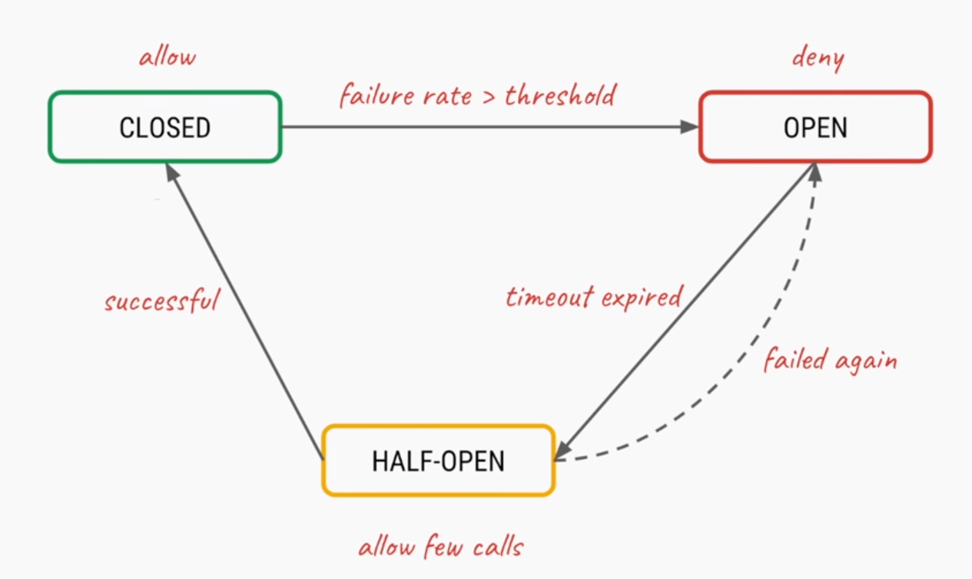
Circuit breaker pattern states

Slide 40
Hands-on
Options for implementing circuit breaker pattern
Self implemented
Steeltoe Hystrix
Polly

Slide 41
Thank you !!

